Slide 1

Table of Contents
Introduction
Strategies for Enhancement
Areas of Improvement
Customer feedback
Conclusion

Slide 2
Costco wholesale (vertical industry)
Presented by group 1
Team members : Ashish Bhavsar
Denso Daniel
Ranjeet Singh
Under Guidance of: Dr. Junaid Qazi

Slide 3

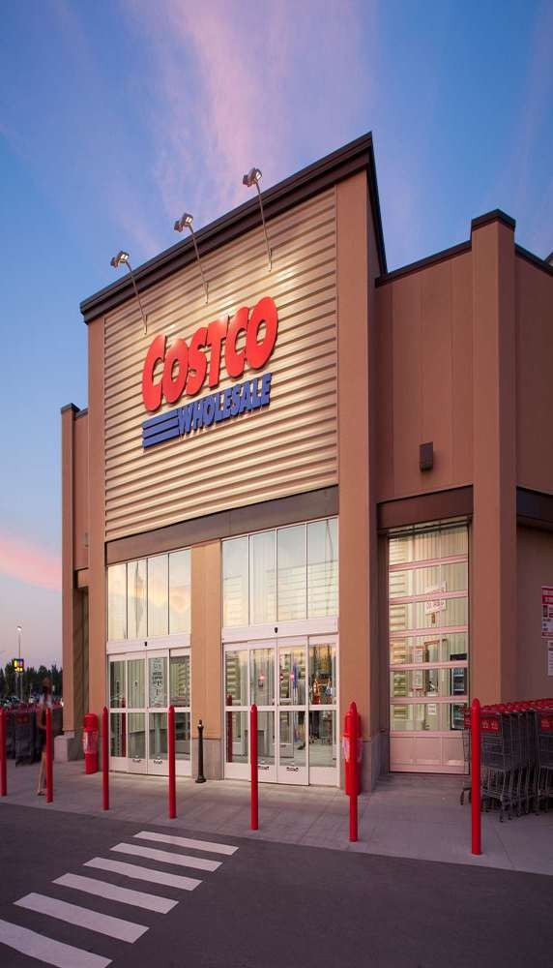

Introduction to Data-Driven
Decision Making
For Costco Wholesale in Calgary, Canada
Group 1

Slide 4

Major Problems
Costco struggles with inconsistent demand forecasting, leading to inventory inefficiencies and supply chain disruptions.
Costco faces a challenge in minimizing food waste and optimizing perishable inventory management across its stores, leading to financial losses and environmental impact.
Group 1

Slide 5

Goals and Objectives
Customer satisfaction
Operational efficiency
Employee development
Supplier relationships

Slide 6
Solutions
Implement data-driven demand forecasting using advanced analytics to optimize inventory levels and enhance collaboration with suppliers for better supply chain management.
Implement a data-driven inventory management system to forecast demand accurately and dynamically adjust ordering and pricing strategies, reducing food waste and improving profitability sustainably.

Slide 7
KPIs Used
Customer Satisfaction
Customer Satisfaction Score (CSAT)
Customer Retention Rate
Operational Efficiency
Cycle Time
First Pass Yield (FPY)
Employee Development
Training Completion Rate Employee Turnover Rate
Supplier Relationships
Supplier On-Time Delivery Rate
Supplier Defect Rate
RA

Slide 8
KPIs Used
Revenue Growth - Measures increase in total sales
Customer Satisfaction - Gauges customer sentiment and loyalty
Profit Margin - Tracks net income as a percentage of revenue
Employee Productivity - Assesses output per employee
Website Traffic - Monitors visitors to a company's online presence
Lead Conversion Rate - Calculates sales closed from marketing leads
Inventory Turnover - Measures how quickly products are sold and replaced
Customer Acquisition Cost - Tracks the cost to obtain a new customer
Churn Rate - Monitors the loss of existing customers over time

Slide 9
Optimizing Store Operations and Inventory Management
Streamlined
Inventory
Efficient
Logistics
Responsive
Staffing
Automated
Processes
Leverage data to optimize product assortment and minimize excess stock
Utilize real-time data to optimize supply chain and distribution
Align staffing levels with customer demand patterns to enhance service
Implement data- driven automation to boost operational productivity

Slide 10
Importance of KPIs for Business Growth
Measure Progress
KPIs track key metrics to assess progress towards goals.
Align Strategy
KPIs link daily operations to high-level business objectives.
Identify Opportunities
KPIs highlight areas for improvement and optimization.
Drive Accountability
KPIs establish clear targets and responsibilities for teams.

Slide 11

Measuring KPIs
1
Quantitative Metrics
Numerical data that can be tracked, analyzed, and compared over time.
2
Qualitative Insights
Contextual feedback and observations that provide deeper understanding.
3
Balanced Approach
Combining quantitative and qualitative data for a comprehensive view.

Slide 12
Cost and Effort to Collect KPIs
Collecting KPIs involves ongoing data gathering, analysis, and reporting - a significant investment of time and resources.

Slide 13
The Process of KPI Collection
1
2
3
4
Identify Metrics
Determine relevant KPIs to track business objectives
Establish Data Sources
Identify where to gather the necessary data
Automate Collection
Implement tools and processes for efficient data gathering
Analyze and Report
Review KPI data, identify trends, and generate insights

Slide 14
KPI Targets and Objectives
Strategic Alignment
Ensure KPIs directly support high-level business goals
1
Measurable Milestones
Set specific, time-bound targets for KPI performance
2
Balanced Scorecard
Combine financial, operational, and customer- focused KPIs
3
Effective KPI targets should be tied to the organization's strategic objectives, with clear milestones and a balance of financial, operational, and customer-centric metrics. This helps ensure KPIs drive meaningful progress across the business.

Slide 15
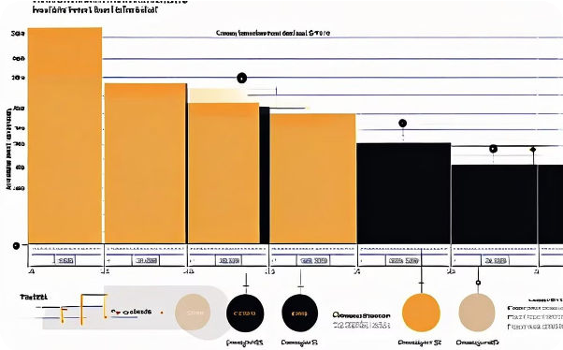
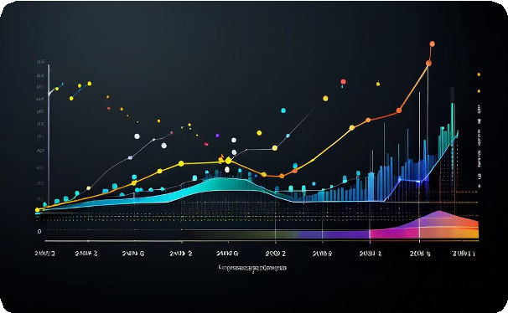

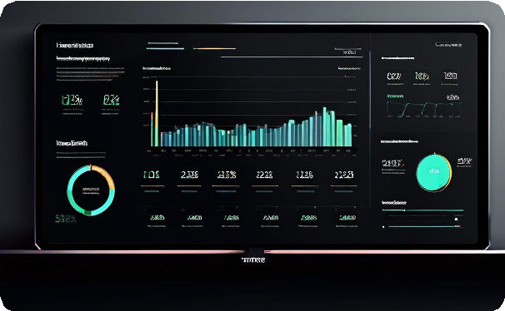

Examples of Effective KPIs
Inventory Turnover
Measures how efficiently a business manages its inventory.
Customer Satisfaction
Tracks customer sentiment and loyalty to the brand.
Revenue Growth
Monitors the company's ability to generate more sales.
Employee Productivity
Assesses output and performance at the individual level.

Slide 16
Conclusion and Key Takeaways
Data-Driven Transformation
Harness data insights to revolutionize Costco Wholesale operations and customer experiences in Calgary.
Operational Excellence
Optimize inventory, logistics, staffing, and automation to boost efficiency and productivity.
Sustainable Growth
Implement strategies for localized assortment, omnichannel integration, and community engagement.
Customer-Centric Focus
Leverage customer feedback and behavior data to enhance friendliness and satisfaction.

Slide 17
Aligning KPIs with Business Goals
Strategic Alignment
Ensure KPIs support high-level business objectives
Measurable Targets
Set specific, time- bound goals for KPI performance
Company-wide Visibility
Share KPI data to promote transparency and accountability
Continuous Optimization
Regularly review and adjust KPIs as the business evolves

Slide 18


Analyzing and Optimizing KPI Performance
Regularly review KPI data to identify trends, uncover insights, and drive continuous improvement.
Analyze KPIs in context, considering external factors and interdependencies across the business.
Optimize KPI targets and data collection processes to ensure they remain relevant and impactful.

Slide 19

Team Contribution
Ashish Bhavsar: Strategies and Areas of Improvement
Denso Daniel: Gathered data and Insights Ranjeet Singh: Created PowerPoint Presentation

Slide 20
References
Google

